Slide 1

Hands-on session: programming
Prof. Toon Calders toon.calders@uantwerpen.be

Slide 2
Goal of this lecture
Get a feeling of what is programming
Focus is on understanding
Writing small snippets of code
This session is hands-on
Introduction of a new concept
One exercise together
Small exercise(s) for you

Slide 3
Goal of this lecture
Learn the basic principles of coding
Sequence of instructions
Loops and repetitions
Conditional execution
Variables
We will use the following examples
Part 1 : Basics (maze)
Part 2 : Variables (loan payments)
Part 3 : Coding decision trees (GDPR)

Slide 4
We Will Use Google Colab
Create a Google account: https://accounts.google.com/ Skip this step if you already have one
Sign in to your Google account (same link)
Follow this link: https://colab.research.google.com/drive/1WrrJ-9o27sMXnGXfcZ1NBW4OuwSFM5dR?usp=sharing
Save a copy of the notebook in your google drive folder
Start by executing the first two cells

Slide 5
Part 1 – Basic Constructions

Slide 6
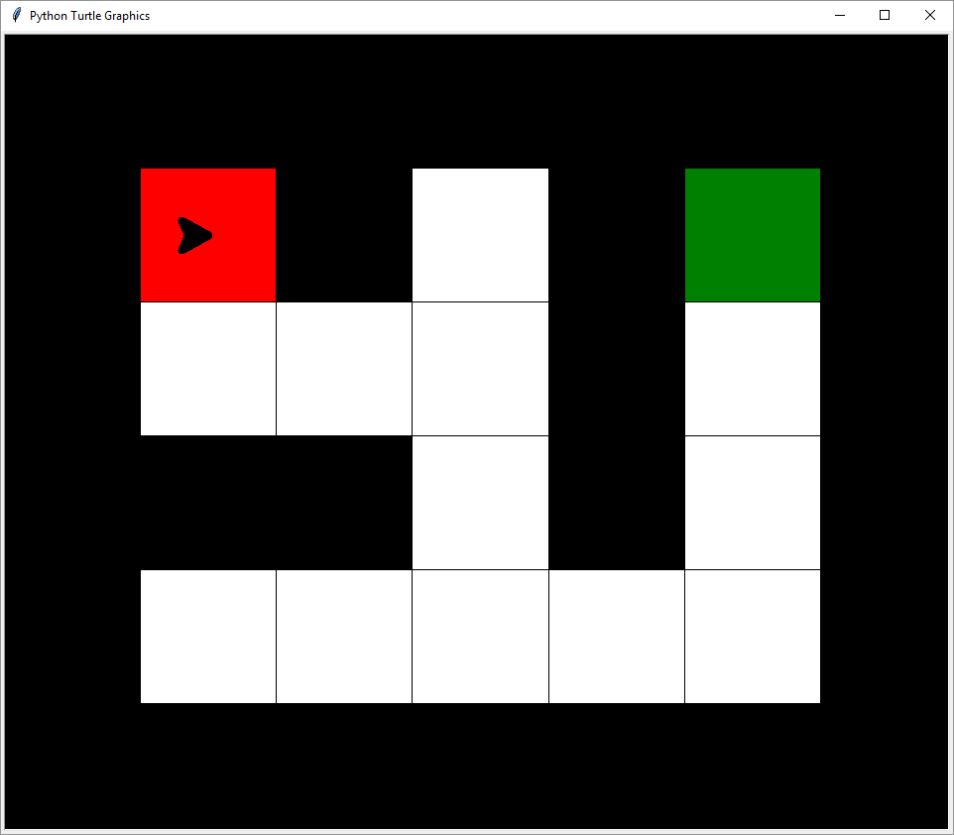
In the first part we will write …
… a Python program for guiding a robot out of a maze
Start
Target
Current position and direction

Slide 7


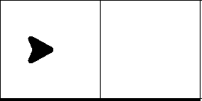

The instructions:
turnLeft()
turnRight()
goForward()

Slide 8
Quick question
Consider the following starting position; what is the position of the robot after the commands on the right ?
turnRight()
goForward()
turnLeft()
goForward()
goForward()
turnRight()
a
b
c

Slide 9
Quick question
Consider the following starting position; what is the position of the robot after the commands on the right ?
turnRight()
goForward()
turnLeft()
goForward()
goForward()
turnRight()
a
a
b
b
c

Slide 10
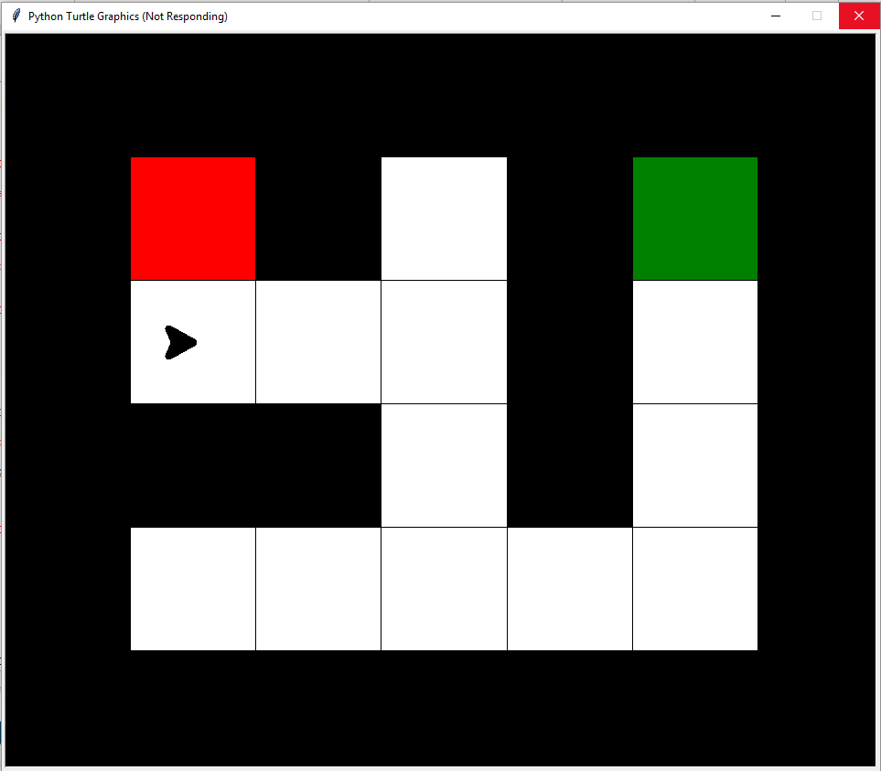
Assignment #1 (q1.py)
Finish the program !
But I’d like to be here!
The program brings me till here

Slide 11
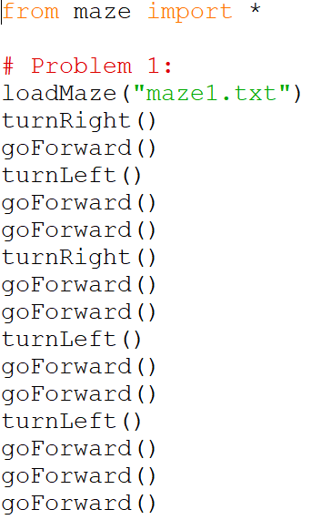
Solution Assignment #1
The next sequence of instructions gets you to the end:

Slide 12

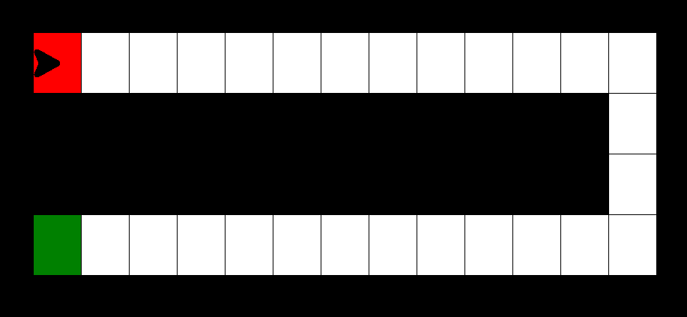
We are repeating ourselves …
goForward()
goForward()
goForward()
goForward()
goForward()
goForward()
goForward()
goForward()
goForward()
goForward()
goForward()
goForward()
turnRight()
goForward()
goForward()
goForward()
turnRight()
goForward()
goForward()
goForward()
goForward()
goForward()
goForward()
goForward()
goForward()
goForward()
goForward()
goForward()
goForward()
Load the second question and execute (q2a.py)

Slide 13
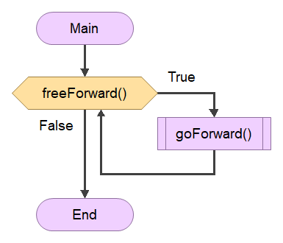

Repetition loop
“As long as you can go straight ahead, proceed and go forward”
You can repeat one instruction ( goForward() ), but also a set of instructions
Use indent (tab!) for the lines to be repeated

Slide 14
New functions
function True if …
freeForward() … the place ahead is free
freeLeft() … the place to your left is free
freeRight() … the place to your right is free
(always respective to your orientation)
foundExit() True only if you are on the target tile
not function() True if function() is False ; False otherwise

Slide 15
Example: Repetition Loop
goForward()
goForward()
goForward()
goForward()
goForward()
goForward()
goForward()
goForward()
goForward()
goForward()
goForward()
goForward()
turnRight()
…
The part to be repeated is indented; use <TAB>
Lower case
Do not forget “:”
while freeForward():
goForward()
turnRight()
…
Repeated part done? Stop indentation! Use <Backspace>

Slide 16
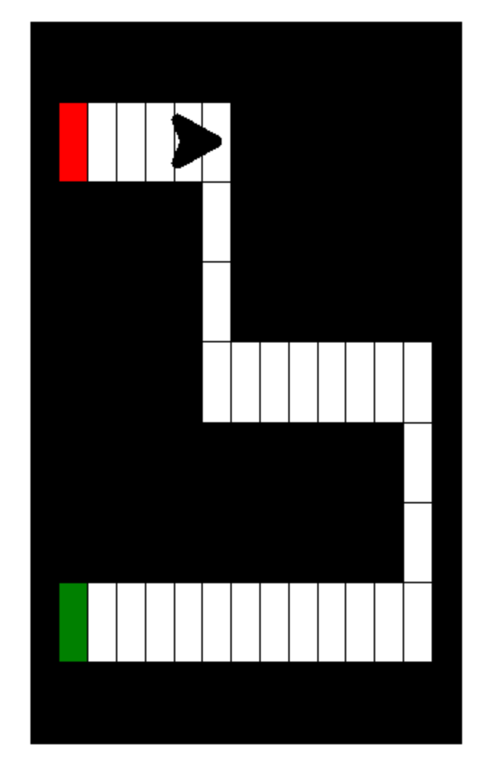
Assignments 2a & 2b
Load the maze and go to the target tile. Use a loop!

Slide 17
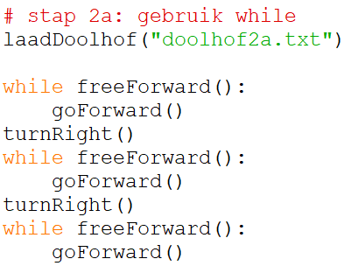
Solution #2a

Slide 18
Solution #2a

Slide 19
Solution #2a

Slide 20
Solution #2a

Slide 21
Solution #2a

Slide 22
Solution #2a

Slide 23
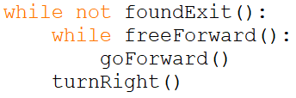
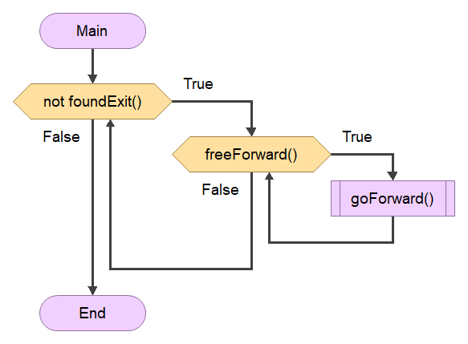
Solution #2a : less code!
+ turnRight()

Slide 24
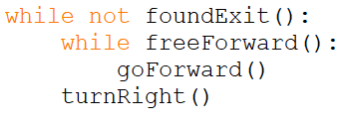
Solution #2a : less code

Slide 25
Solution #2a : less code
?

Slide 26
Solution #2a : less code

Slide 27
Solution #2a : less code

Slide 28
Solution #2a : less code

Slide 29
Solution #2a : less code
?

Slide 30
Solution #2a : less code

Slide 31
Solution #2a : less code

Slide 32
Solution #2a : less code

Slide 33
Solution #2a : less code
?

Slide 34
Solution #2a : less code

Slide 35
Solution #2a : less code

Slide 36
Solution #2a : less code

Slide 37
Solution #2a : less code
?

Slide 38
Solution #2a : less code

Slide 39
Solution #2a : less code

Slide 40
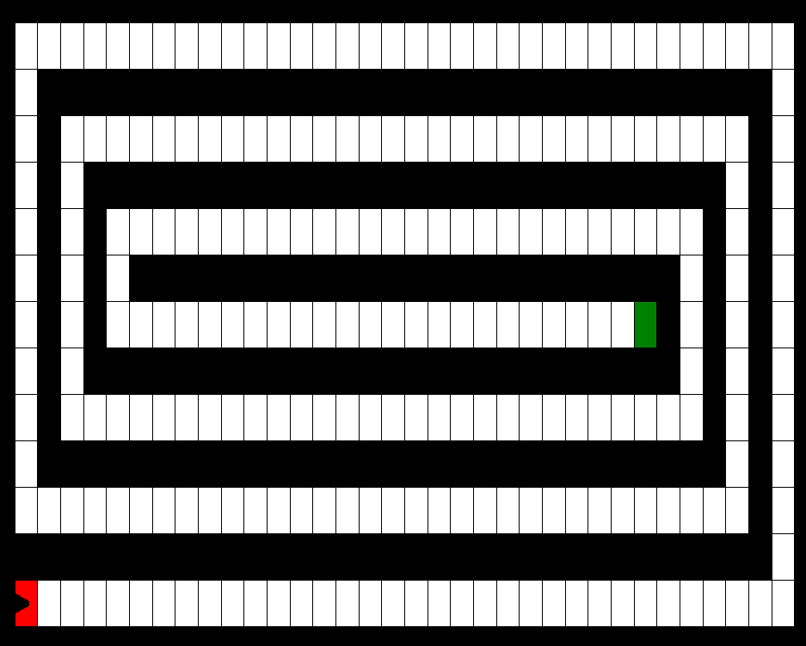
Assignment #2c (q2c.py)
Go to the target tile in the following maze:

Slide 41
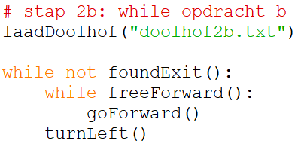
Solution #2c

Slide 42
Solving Arbitrary Mazes
Until now: only programs for solving specific mazes; the solution for Q1 doesn’t work for Q2 and vice versa.
Can we write programs that are flexible enough to solve any maze ?
Implies that we need to make choices depending on the situation:
If left is free, then turn left
else if right is free, then turn right
else go forward

Slide 43
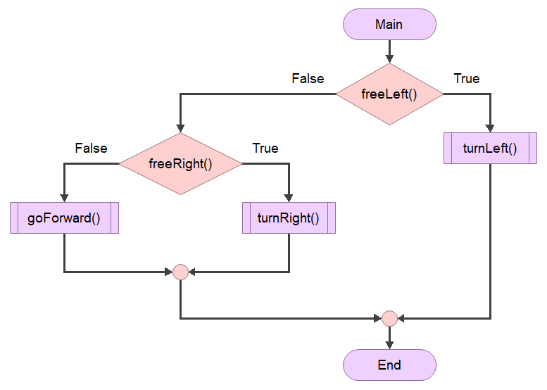
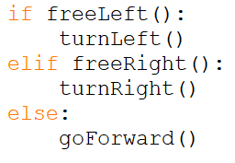
if – elif - else
This is exactly what if – elif – else does in Python:
If left is free, then turn left
else if right is free, then turn right
else go forward

Slide 44

if – elif - else
This is exactly what if – elif – else does in Python:
lowercase
Do not forget “:”
if, elif, or else done? unindent (use <Backspace>)
The conditional parts are indented; use <TAB>

Slide 45
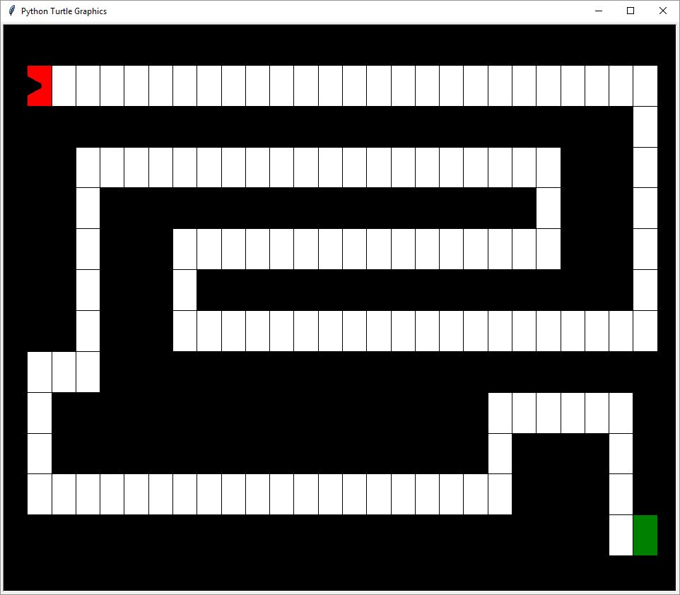
Assignment #3 a q3a.py
Solve maze number 3a:

Slide 46
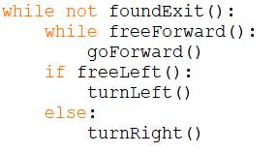
Solution #3a

Slide 47
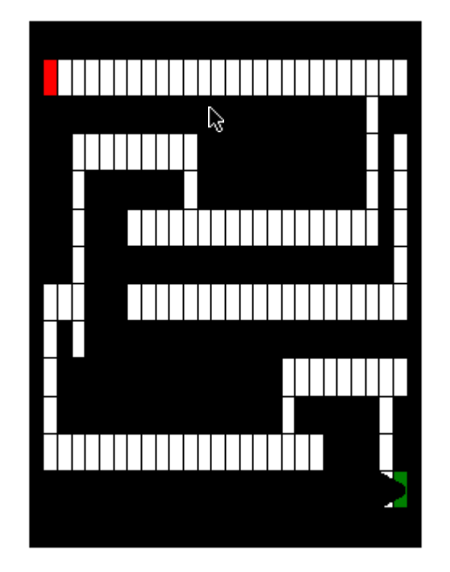
Assignment #3 b q3b.py
Solve maze number 3b:
Hint:
Conditions can be combined with and, or, not
while not freeRight() and not freeLeft():
…

Slide 48
The next slides are extra for those interested in a generic solution for any maze* * with entrance and exit at the exterior wall
To summary slide

Slide 49

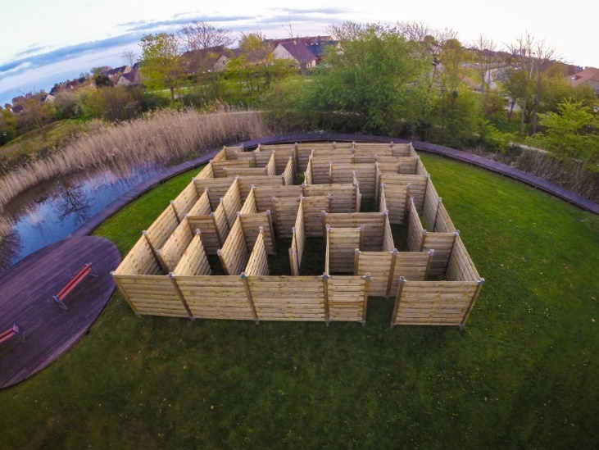
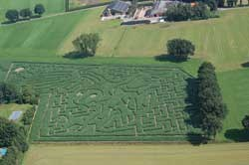
Righthand rule
If start and end positions in the maze are both next to the exterior wall, the following algorithm always finds a path to the target position:
Always follow the rightmost path
(Make sure your right hand always touches the wall)

Slide 50

Righthand rule
Follow the rightmost path
Where to go next in this example?
(a)
(b)

Slide 51
Righthand rule
Follow the rightmost path
Where to go next in this example?
(a)
(b)

Slide 52
Righthand rule
Follow the rightmost path
Where to go next in this example?
(a)
(b)
(c)

Slide 53
Righthand rule
Follow the rightmost path
Where to go next in this example?
(a)
(b)
(c)

Slide 54
Righthand rule
Follow the rightmost path
Where to go next in this example?
(a)
(b)

Slide 55
Righthand rule
Follow the rightmost path
Where to go next in this example?
(a)
(b)

Slide 56
Righthand rule
Follow the rightmost path
Where to go next in this example?
(a)
(b)

Slide 57
Righthand rule
Follow the rightmost path
Where to go next in this example?
(a)
(b)

Slide 58
Righthand rule
Follow the rightmost path
Where to go next in this example?
(a)
(b)

Slide 59
Righthand rule
Follow the rightmost path
Where to go next in this example?
(a)
(b)

Slide 60
Righthand rule
Always follow the rightmost path
=
Until you reach the exit, repeat:
if right is free:
turn right and go forward
else if forward is free:
go forward
else if left is free is:
turn left and go forward
else:
turn 180 degrees and go forward

Slide 61
Assignment #4 - together q4.py
Implement the righthand rule. You can test on maze #4.
Always follow the rightmost path, until you reach the end
Finished? Try also maze #5!

Slide 62
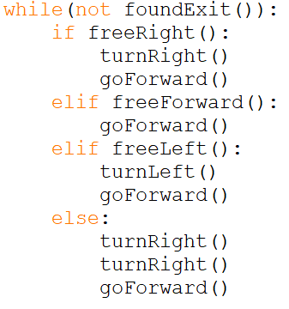
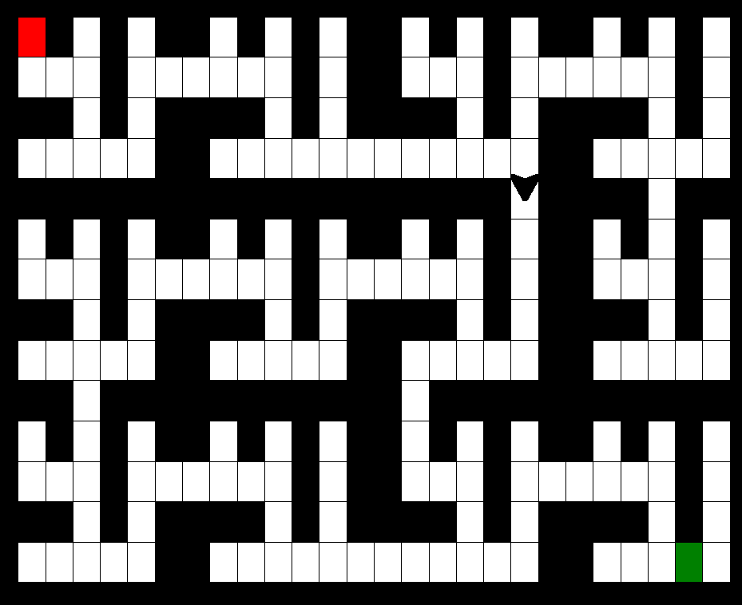
Solution #4
As long as you haven’t reached the exit:
Search the rightmost free next position
go forward

Slide 63
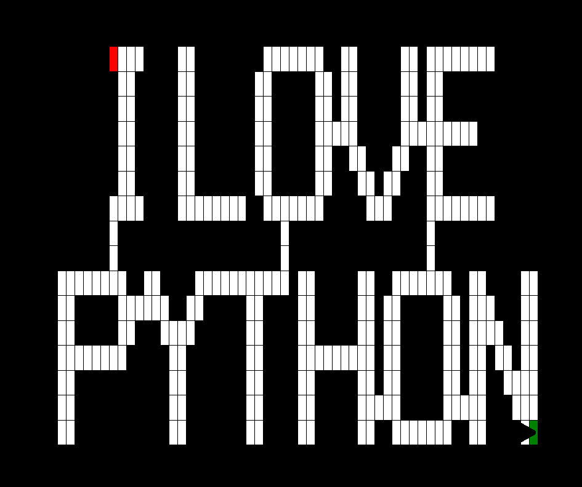
Summary Part 1
Programming = give step-wise instructions to solve a problem.
Important constructions:
Sequence of commands : execute one by one
Repetition loops : while … repeat …
Conditional execution : if … elif … else …
One important concept is still missing:
Variables to temporarily store things in memory

Slide 65
Part 2 - Variables

Slide 66

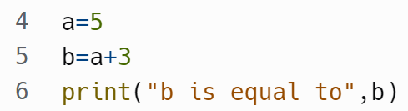
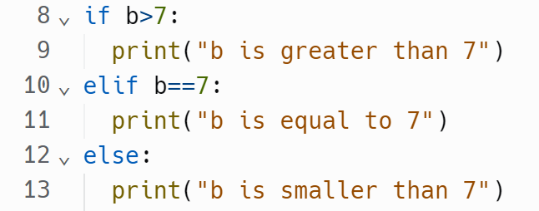
Part 2 - Variables
Variable : place to store a value in memory
We can do computations with variables:
Use them in if’s:

Slide 67
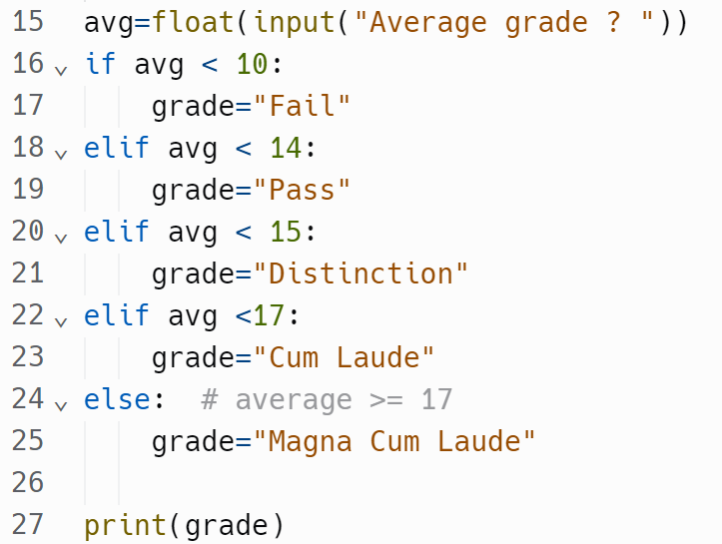


Variables - Example
Ask the average grade, tell Python it is a real number (float)
15
?
?
?
Variable grade is made and given value “Cum Laude”
?
Cum Laude

Slide 68
Exercise 5 – Generation
Ask birthyear hint: a number is “int” → y=int(input(…
Categorize into:
The Baby Boomer Generation – born 1946-1964.
Generation X – born 1965-1979.
Millennials – born 1980-1994.
Generation Z – born 1995-2012.
Gen Alpha – born 2013 – 2025.
Print the generation someone born in that year belongs to

Slide 69
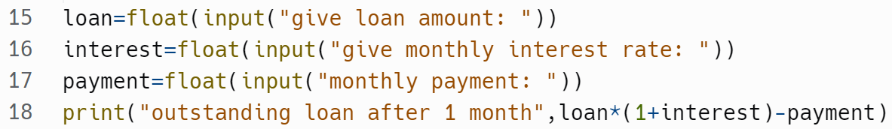
Example : interest rate
10000
0.01
150
9950.0
Variable | value
loan | 10000.0
interest | 0.01
payment | 150.0

Slide 70
Reference – operations
operation | meaning | example | result
+ | addition | 3 + 6 | 9
- | subtraction | 3.0 - 7 | -4.0
* | multiplication | 1.7 * 100 | 170.0
/ | division | 9/2 | 4.5
// | int division | 9//2 | 4
% | remainder | 9%2 | 1
== | equality | 2 == 1+1 | True
!= | inequality | 2 != 3 | True
> | more | 5+3 > 6+2 | False
< | less | 5 < 6 | True
<= | less or equal | 3<=2 | False
>= | more or equal | 5+3 >= 6+2 | True

Slide 71
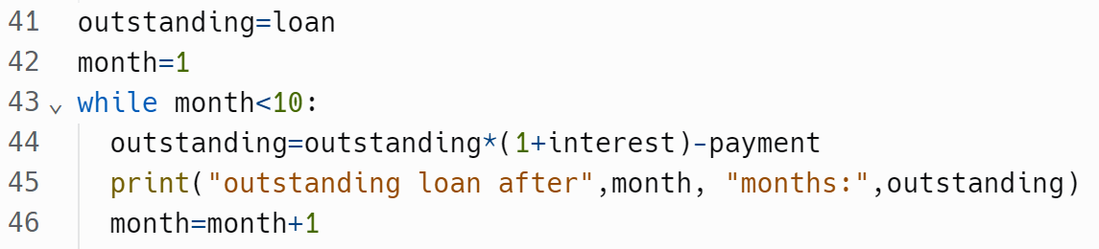
Payment Table
Execute for month ranging from 1 to (not including) 10
Variable | value
loan | 10000.0
interest | 0.1
payment | 150.0

Slide 72
Payment Table
Variable | value
loan | 10000.0
interest | 0.1
payment | 150.0
outstanding | 10000.0

Slide 73
Payment Table
Variable | value
loan | 10000.0
interest | 0.1
payment | 150.0
outstanding | 10000.0
month | 1

Slide 74
Payment Table
Variable | value
loan | 10000.0
interest | 0.1
payment | 150.0
outstanding | 10000.0
month | 1

Slide 75
Payment Table
Variable | value
loan | 10000.0
interest | 0.1
payment | 150.0
outstanding | 10850.0
month | 1

Slide 76
Payment Table
Variable | value
loan | 10000.0
interest | 0.1
payment | 150.0
outstanding | 10850.0
month | 1
Outstanding loan after 1 months: 10850.0

Slide 77
Payment Table
Variable | value
loan | 10000.0
interest | 0.1
payment | 150.0
outstanding | 10850.0
month | 2
Outstanding loan after 1 months: 10850.0

Slide 78
Payment Table
Variable | value
loan | 10000.0
interest | 0.1
payment | 150.0
outstanding | 10850.0
month | 2
Outstanding loan after 1 months: 10850.0

Slide 79
Payment Table
Variable | value
loan | 10000.0
interest | 0.1
payment | 150.0
outstanding | 11785.0
month | 2
Outstanding loan after 1 months: 10850.0

Slide 80
Payment Table
Variable | value
loan | 10000.0
interest | 0.1
payment | 150.0
outstanding | 11785.0
month | 2
Outstanding loan after 1 months: 10850.0
Outstanding loan after 2 months: 11785.0

Slide 81
Payment Table
Variable | value
loan | 10000.0
interest | 0.1
payment | 150.0
outstanding | 11785.0
month | 3
Outstanding loan after 1 months: 10850.0
Outstanding loan after 2 months: 11785.0

Slide 82
Payment Table
Variable | value
loan | 10000.0
interest | 0.1
payment | 150.0
outstanding | 11785.0
month | 3
Outstanding loan after 1 months: 10850.0
Outstanding loan after 2 months: 11785.0

Slide 83
Payment Table
Variable | value
loan | 10000.0
interest | 0.1
payment | 150.0
outstanding | 12813.5
month | 3
Outstanding loan after 1 months: 10850.0
Outstanding loan after 2 months: 11785.0

Slide 84
Payment Table
Variable | value
loan | 10000.0
interest | 0.1
payment | 150.0
outstanding | 12813.5
month | 3
Outstanding loan after 1 months: 10850.0
Outstanding loan after 2 months: 11785.0
Outstanding loan after 3 months: 12813.5
…

Slide 85
Payment Table
Variable | value
loan | 10000.0
interest | 0.1
payment | 150.0
outstanding | 21542.55…
month | 9
Outstanding loan after 1 months: 10850.0
Outstanding loan after 2 months: 11785.0
Outstanding loan after 3 months: 12813.5
…
Outstanding loan after 9 months: 21542.6

Slide 86
Payment Table
Variable | value
loan | 10000.0
interest | 0.1
payment | 150.0
outstanding | 21542.55…
month | 10
Outstanding loan after 1 months: 10850.0
Outstanding loan after 2 months: 11785.0
Outstanding loan after 3 months: 12813.5
…
Outstanding loan after 9 months: 21542.6

Slide 87
Payment Table
Variable | value
loan | 10000.0
interest | 0.1
payment | 150.0
outstanding | 21542.55…
month | 10
Outstanding loan after 1 months: 10850.0
Outstanding loan after 2 months: 11785.0
Outstanding loan after 3 months: 12813.5
…
Outstanding loan after 9 months: 21542.6

Slide 88
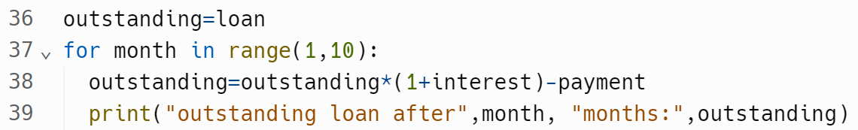



Note: for versus while
Everything we can do with for we can also do with while:

Slide 89
Exercise 6 – interest rate
Change the code:
Ask the user for how many years they want the table
Print the monthly table for that many years
Extensions:
Stop if the outstanding amount reaches (or becomes lower than) 0
Compute the total payment
Take into account that the last payment is not for the full amount, but such that the balance is exactly 0

Slide 90
Summary Part 2
Variables to store values
Different types : int, float, string
Calculations with numbers
+, -, *, /, //, %
Comparing values
>, <, ==, !=
Loops that are indexed by variables:
for variable in range(start,end):

Slide 91
Part 3 - Coding Decision Trees

Slide 92
Decision trees for regular use cases

Slide 93
Example
Write a program that checks if a given year is a leap year or not. A leap year is divisible by 4, but not by 100, unless it is divisible by 400. E.g. 2004 and 2000 are leap years, but 1800 and 1900 not.
y%4 : remainder after division by 4
y%4 == 0 : True if y is a multiple of 4
7%4 == 3 → 7 not divisible by 4
8%4 == 0 → 8 divisible by 4

Slide 94
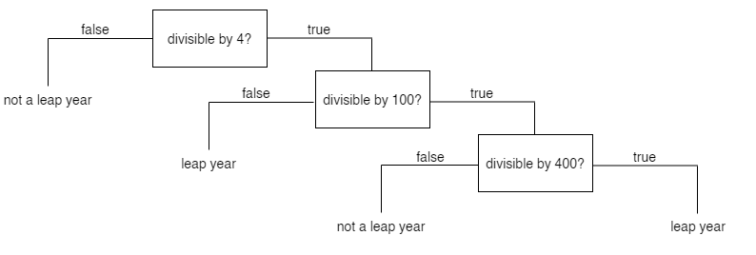

Slide 95
2004

Slide 96
1900

Slide 97
Let’s code!

Slide 98
year = int(input("year?"))
if (year % 4 !=0):
print("not a leap year")
else:
if (year % 100 != 0):
print("leap year")
else:
if (year % 400 != 0):
print("not a leap year")
else:
print("leap year")

Slide 99
Decision trees in law practice

Slide 100
Case 1

Slide 101
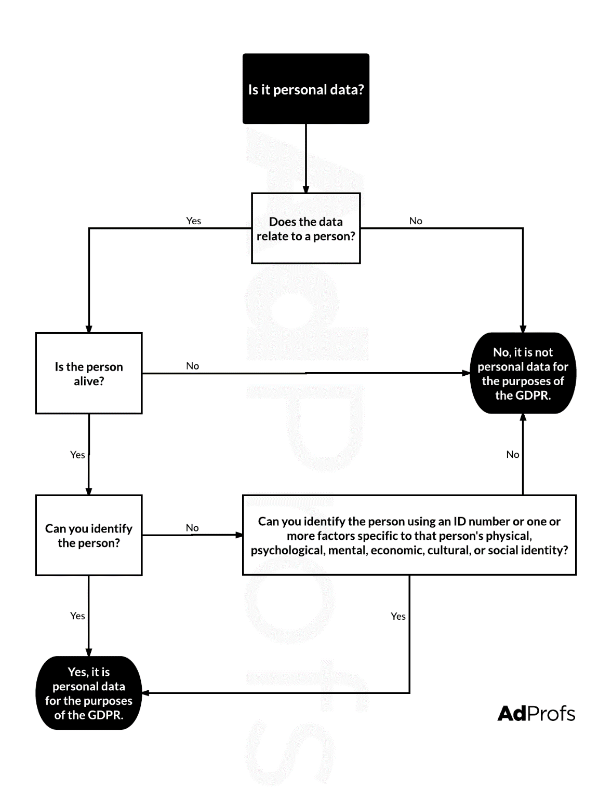
Q7: GDPR

Slide 102
Case 2

Slide 103
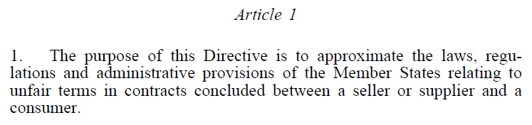
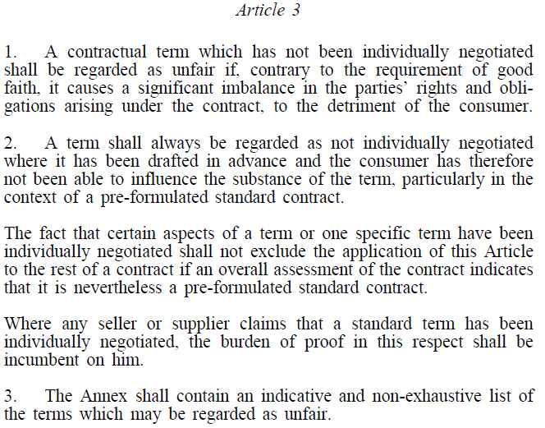
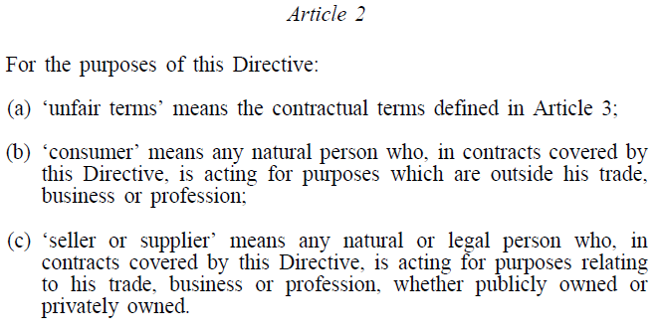
Q8 - Unfair contract terms
Directive 93/13 (the Unfair Contract Terms Directive) bans the use of certain terms in contracts between traders and consumers
Key provisions:

Slide 104
Q8 - Unfair contract terms
Is a term in a bilateral contract unfair in the sense of Directive 93/13?
A consumer is any natural person who is acting for purposes which are outside his trade, business or profession
Is one party to the contract a consumer?
No
The directive does not apply to this contract
Yes
Is the other party to the contract a consumer?
Yes
No
Is the term individually negotiated (i.e. does it concern the main subject of the contract)?
Yes
No
Yes
Does the term fall within the categories listed in the annex to the Directive?
The term is unfair in the sense of Directive 93/13
No
Is the term contrary to the requirement of good faith and does it cause a significant imbalance in the parties’ rights and obligations arising under the contract, to the detriment of the consumer?
The term is not unfair in the sense of Directive 93/13
Yes
No

Slide 105
Summary Part 3
Coding decision trees:
First problem analysis
Then coding the logic
Current developments:
Using generative AI to write code
Need to know how to phrase (divide in blocks)
Understand code and make small modifications

Slide 106
Summary
Python has many powerful libraries:
Easy to use : import [name of library]
Learn more?
Online courses; e.g. : https://snakify.org/
You can use genAI to assist your code writing
Debug your code, write tests
Use it for boring, repetitive tasks
Develop an interface for your program
Suggest libraries to use

Slide 107
